Slide 1
Unit 0: Welcome
IY3501: Security Management
Dr Joe Reddington

Slide 2
Objectives of the Unit
Introduce the module and myself​
Explain the high-level and weekly structure​
Explain how the module is assessed​
Discuss formative assignments and feedback​
Make sure everybody knows where to ask questions or get help.

Slide 3
Module Content

Slide 4
Module Statement
This module is concerned with how to use security technology, processes and people to protect an organisation’s assets, to enable the organisation to achieve its business
goals

Slide 5
Module Statement
This module is concerned with how to use security technology, processes and people to protect an organisation’s assets, to enable the organisation to achieve its business goals

Slide 6
High-level module overview
We look at frameworks, standards and best practices for security management
We cover in detail the controls, policies and processes that organisations may use
We study the legal and regulatory context
We consider the application of these in various business contexts and consider explicit case studies

Slide 7
Content
8 units of content
1hr synchronous online session (Monday)
Lots of information
2hrs synchronous F2F session (Friday)
More interactive

Slide 8
The 8 units are:
Introduction
Standards
Risk
Controls
Incident Management
Law and Ethics
Staff Management
Audit

Slide 9
Content Warning
Security relates directly to harm, and particular demographics get harmed more.
This module contains a lot of examples of harm. They are presented without unnecessarily detail, but they do exist.
Disability is referenced a lot.

Slide 10
Content Warning 2
IY3501 provides a non-technical introduction to security management
This module will not
Have much mathematics
Require any programming

Slide 11
Learning Outcomes
By the end of the module students should be able to:
Evaluate security management requirements
Analyse critically alternative security management strategies and methods
Propose effective methods for responding to security management problems
Compare and critically evaluate different approaches to security management
Make Smart Decisions about risk

Slide 12
Other Questions we will ask
Security incidents such as data breaches are impossible to completely avoid
How do businesses manage this risk in practice?
How are incidents handled when they do occur?
What lessons can we learn from such incidents?

Slide 13
Learning Outcomes As Questions
By the end of the module students should be able answer these questions
Is our security good enough for the insurers to cover us?
Which security framework works best for our business?
Some idiot left a laptop on a train – what do we do now?
Which of these four people bidding for our security contract is any good?

Slide 14
Module Assessment

Slide 15
Assessment
Coursework (40%):
2,500 words individual report/case-study
Deadline in January (see Moodle)
I will be consulting you on how you want your feedback
Examination (60%):
2-hour final examination: format uncomfirmed

Slide 16
Summative assessment
The summative assessment asks to produce a 2,500-word report on a security incident that covers:
Business context, including regulatory and legal context
Timeline of the incident and how it unfolded
Impact of the incident on the business
Cause(s) of the incident, including the associated risks and any mitigation strategies that were in place
Failures or weaknesses in security management that the incident highlights and lessons that can be learnt
Suggestions for improvements to the security management processes that the business could implement

Slide 17
Summative assessment
The summative assessment AIS and mark scheme are on Moodle
An assignment guide will be published giving further details
There will be a lecture devoted to this assessment.
Average mark for the last two years was 64 and 66. Best mark ever was about 80.

Slide 18
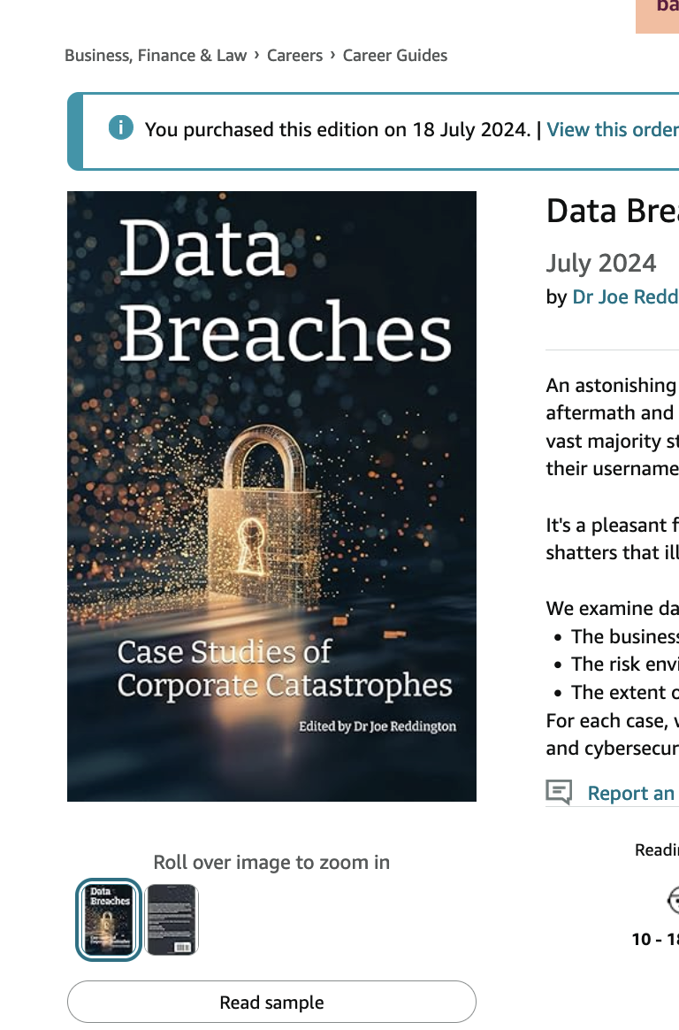
Summative assessment 2
Last year and the year before that, ten of the best reports were collected into a book and published.
I'll be doing it again this year. There will be rules for entry
Ideally, I'll get to a proper peer-review system with each edition focusing on a 12 month period.

Slide 19
Summative assessment and GenAI
I’m inclined to fully allow GenAI this year.
However, the mark scheme and referencing system have both been rewritten to favour human skills

Slide 20
Assessment
Two formative assessments
Not compulsory and not for credit.
One is the first half of the coursework

Slide 21
Feedback on formative assignments
Feedback will not be provided for late submissions
- If you would like feedback, please submit by the deadline
Model answers will not be provided
- In many cases, many answers are possible
- Happy to discuss feedback received during office hours

Slide 22
About Me

Slide 23
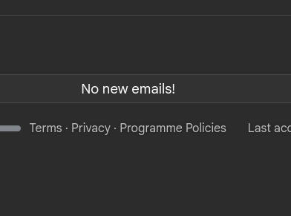
About me
Dr Joe Reddington (he/him)
Part time
Contact:
j.reddington@rhul.ac.uk (Inbox normally processed on Wednesdays)
Teams isn't for me
Bedford 2.05

Slide 24
About me that you are interested in.
Can I talk to Computer Scientists?
Do I know anything about business and risk?
Can I teach well?

Slide 25
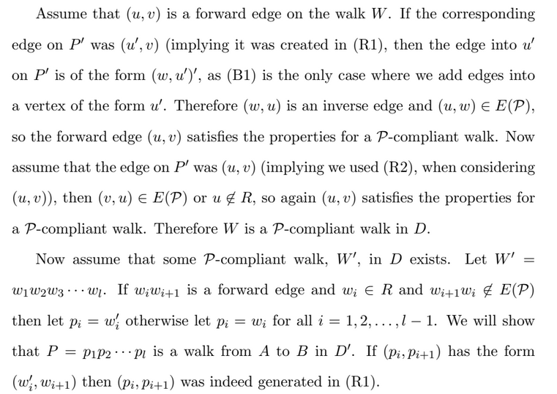
Can I talk to Computer Scientists?
CS/Maths background
I write code every working day

Slide 26
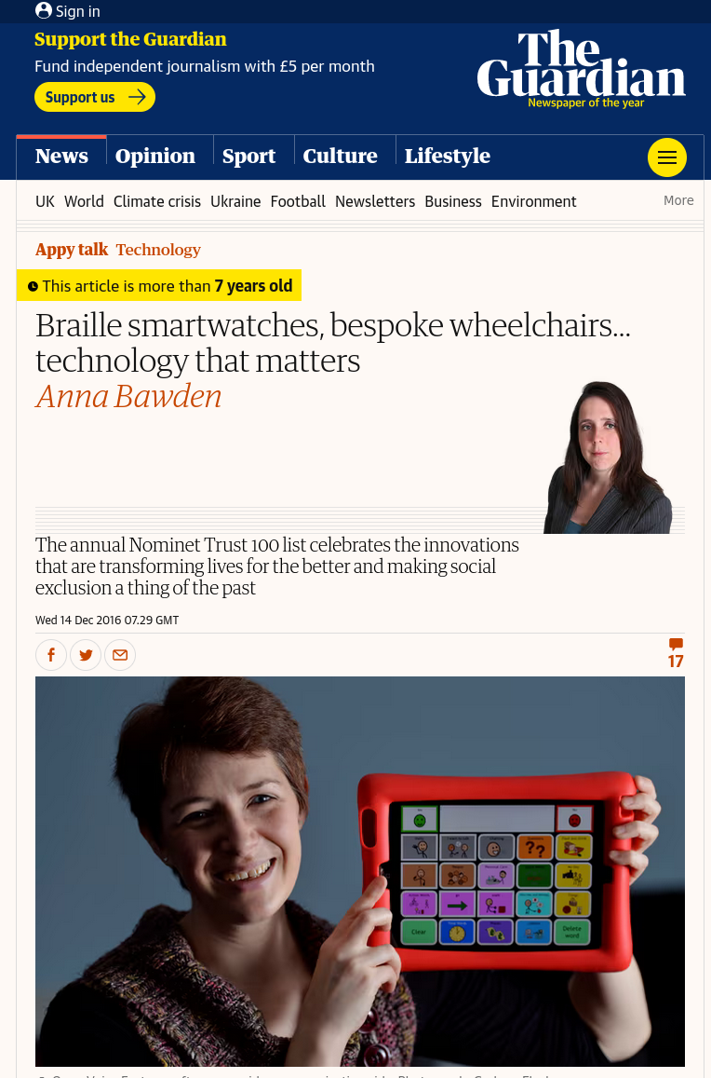
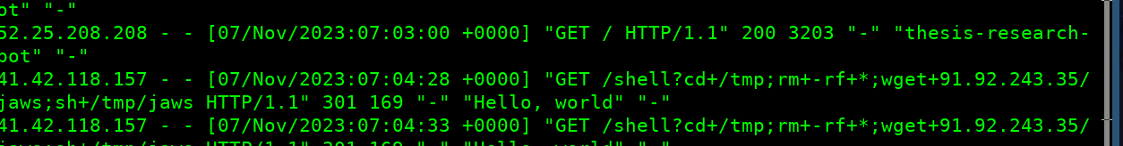
Do I know anything about business?
Since 2014 I’ve run the limited company/charity eQuality Time

Slide 27
Can I teach well?
Yes

Slide 28
Office hours
Directly after lectures so:
Monday 2-3pm (online)
Fridays 3-4pm (online/in person)

Slide 29
Module Culture

Slide 30
Questions
A lecture with fewer than 16 questions has failed.
I leave time at the start of every session so people who watched the recording/people who thought about it later/people who emailed, can have their questions batched up.
Several lectures this year will be fully Q&A

Slide 31
Attendance
Some people learn better from lecturers and interactivity
Some learn better from reading the books
Some learn better from watching videos at home.
These are all entirely valid. However, I need to know who is in the room.

Slide 32
Attendance
To do this job well I need to know who is in the room
Am I disproportionately missing people with access needs?
Am I disproportionately missing EAL students?
I don’t care about your personal attendance; I care about good data.
So we use CASPER.

Slide 33
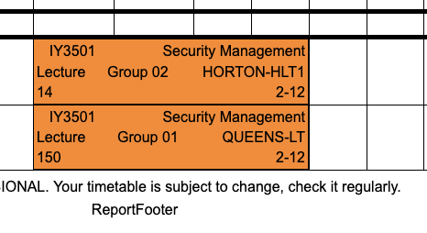
Prayer

Slide 34
Bonus readings
Please read this Reddit thread before Friday: https://www.reddit.com/r/LegalAdviceUK/comments/1joxfdy/being_approached_by_ex_employer_to_fix_system/

Slide 35
Objectives of the Unit
Introduce the module and myself​
Explain the high-level and weekly structure​
Explain how the module is assessed​
Discuss formative assignments and feedback​
Make sure everybody knows where to ask questions or get help.

Slide 36
Unit 0: Welcome
IY3501: Security Management
Dr Joe Reddington

